Slide 1


Russian Political Turmoil
and Olympic Performance
1952-2010

Slide 2
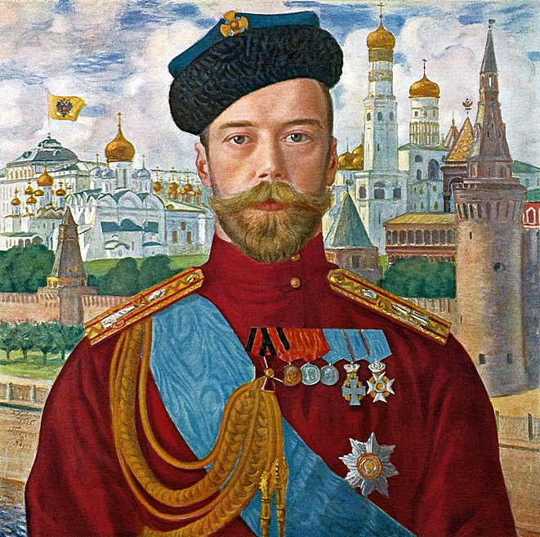
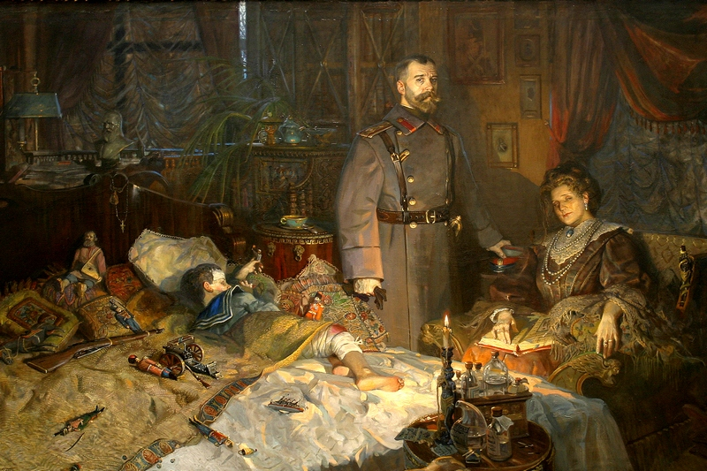

Brief Overview of 20th Century Russian History
In 1917 , as a result of the February Revolution, Tsar Nicholas II was forced to abdicate and a year later his who family was executed.
A bloody civil war followed until a treaty was signed in 1922.

Slide 3
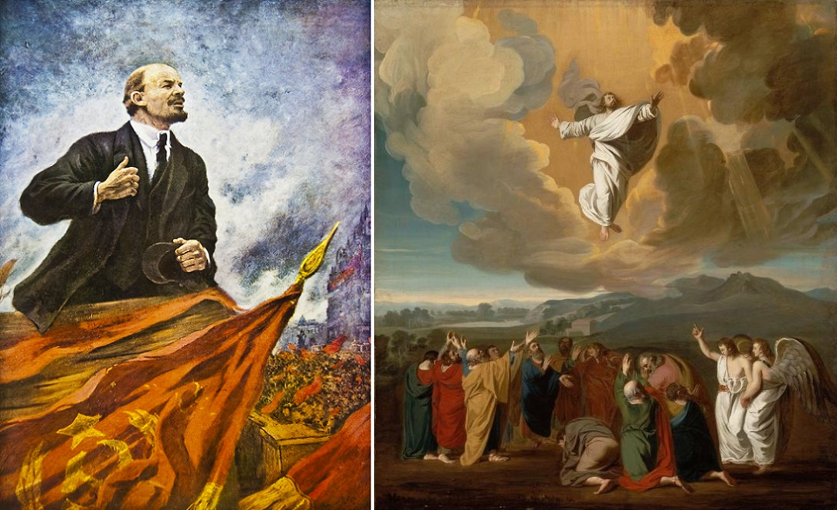
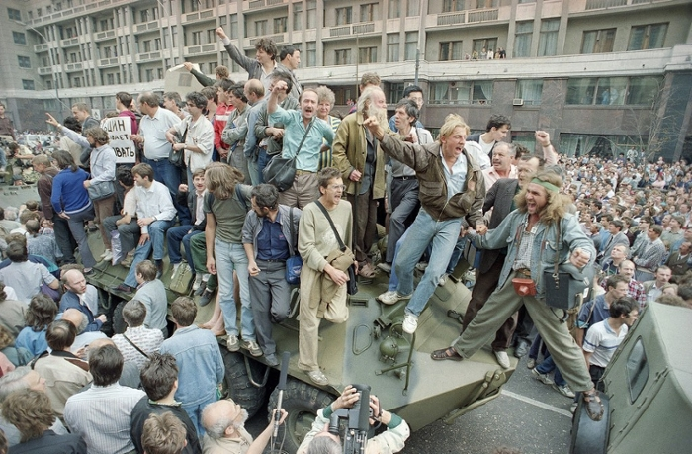
The Communist Party lead by Lenin and then by Stalin and others would hold power until the collapse of the Soviet State in 1991. The USSR broke into the Russian Federation and 15 Post-Soviet States.
The People of the Soviet Union would endure famine, The GULAG system, The Great Purge, WWII, and the Cold War.
61 million Russians were killed in total by The Soviet Gulag State and 11 million Russian Soldiers died in WW2

Slide 4
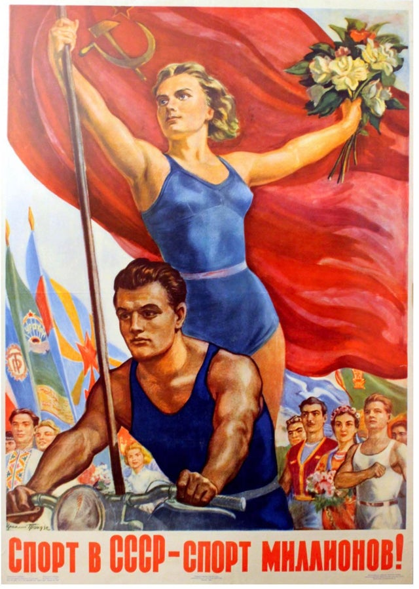
The 1950’s brought the death of Stalin and the entry of Soviet Athletes to the world stage via participation in Olympic Games How did the dramatic events of Soviet History in the 20th Century effect Soviet/ Russian Olympic Athletes before and after the fall of the Soviet State?

Slide 5
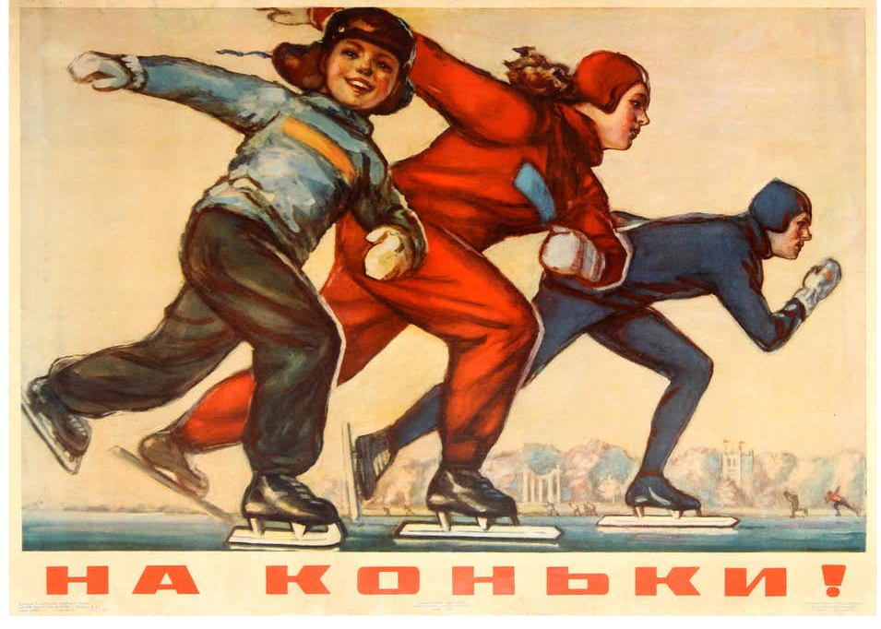
Olympic Performance – USSR/ Russia

Slide 6
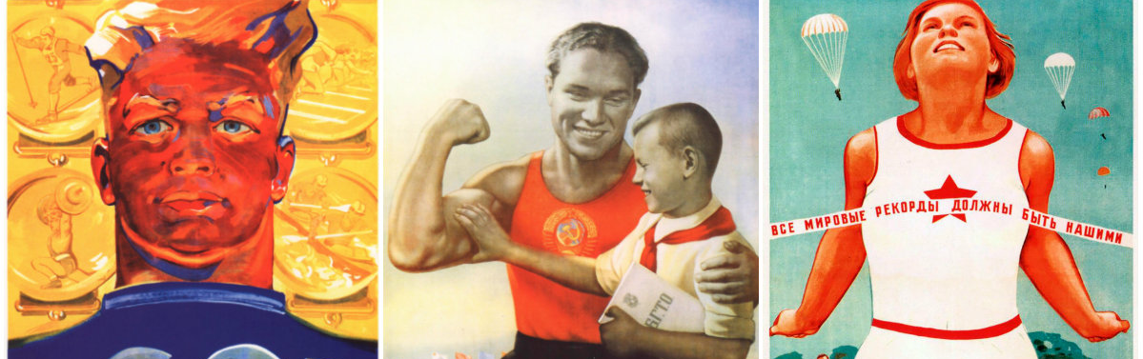
Scope
Examine Olympic performance of USSR / Russian Federation for 10 games before and after the 1991 dissolution of the USSR.

Slide 7
Source Material
GDP - Kaggle
Population Dataset – United Nations
Olympic Dataset – Kaggle
NPR and a wide variety of historical material

Slide 8


Data Cleaning Process
We filtered the datasets by country, gender, Olympic Medal Counts, population, GDP, and Years using pandas, matplotlib, python.
We cleaned the data tables so they were in a usable format for charting.
We cleaned and merged multiple data sources for GDP.
Determined there were multiple codes for Soviet Union/Russia as the break-up happened
Population data set was filtered by Olympic years. It also had to be grouped and summed according to historical borders.

Slide 9
Methods / Attributes Used for Faster Troubleshooting, Formation of New Charts, and for Plotting
shape
describe()
head()
list()
Pyplot
Plot
for loop through a range of years by increments of 2 or 4
replace()
rename()
apply(pd.numeric)
extend()
sum()
cumulative sum
concatenation
info()
isin()
groupby
stats.ttest
seaborn
st.pearsonr
df.dropna
lineregress
pd.merge

Slide 10

Ratika Chauhan

Slide 11
Hypothesis Testing
T – Test

Slide 12
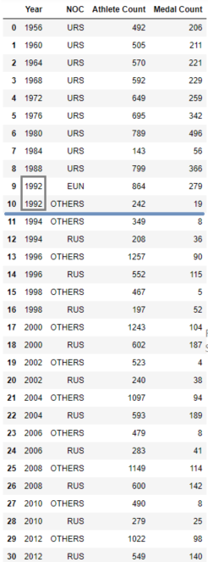
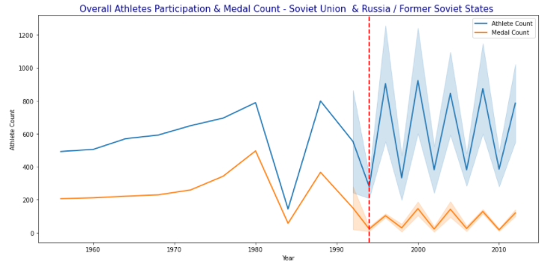
Compete Analysis – Future Analysis Soviet Union vs. Russia /Former Soviet States
Scope of our project is narrowed down to analyze the impact of dissolution on the performance of Russia in Olympics before and after 1992
Q: Did the dissolution impact the participation rate and total medals won by Soviet Union as a team vs. Russia / Former Soviet States
A: The athlete's participation went up, but the number of medals went down after 1992 Olympics
#The former Soviet states referred as OTHERS are Armenia, Azerbaijan, Belarus, Estonia, Georgia, Kazakhstan, Kyrgyzstan, Latvia, Lithuania, Moldova, Tajikistan, Turkmenistan, Ukraine and Uzbekistan
#Other_counties_list= ['ARM','MDA','EST','LAT','LTU','GEO','AZE','TJK','KGZ','BLR','UZB','TKM','UKR','KAZ']

Slide 13
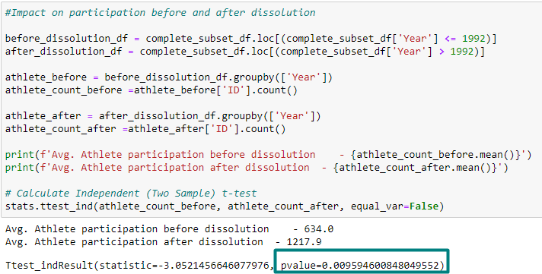
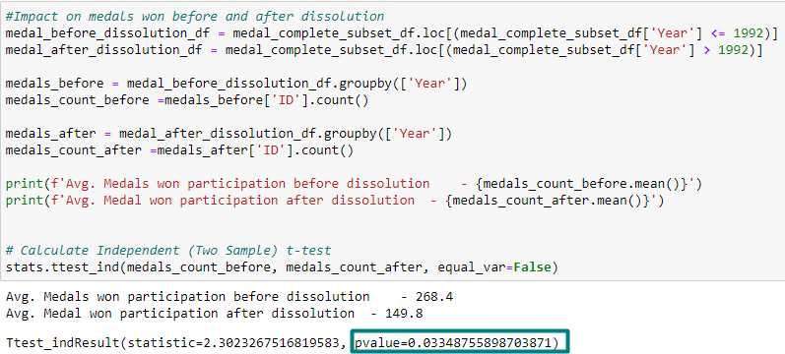
Complete Analysis T-Test Soviet Union vs. Russia /Former Soviet States
Did the dissolution impact the athlete’s participation in Olympics before and after 1992?
Athlete Participation Analysis - The average participation of athletes went up drastically. The t-test shows p-value of 0.0095 indicating strong evidence against the null hypothesis and therefore we can reject the Null hypothesis and accept alternate hypothesis
Did the dissolution impact the total number of medals before and after 1992?
Medals won Analysis - The p-value for medal analysis is 0.003 .It indicates evidence against the null hypothesis, as there is less than a 5% probability the null is correct (and the results are random). Therefore, we reject the null hypothesis, and accept the alternative hypothesis for our further analysis
#Includes Soviet Union, Russia and other countries part of former USSR
complete_subset_df =olympics_dataset[olympics_dataset['NOC'].isin(complete_noc_list) & (olympics_dataset['Year'] >= 1956) & (olympics_dataset['Year'] <= 2012)]

Slide 14
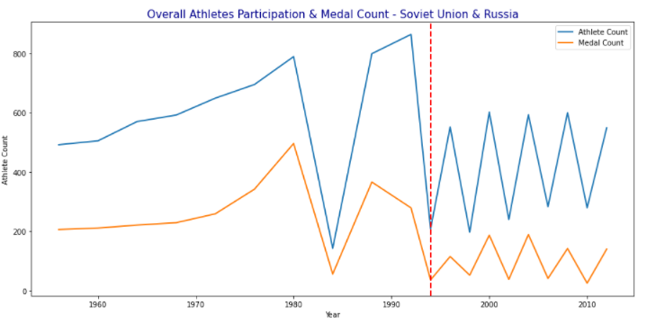
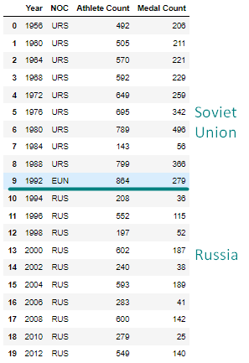
Project Scope Analysis Soviet Union vs. Russia
Scope of our project is narrowed down to analyze the impact of dissolution on the performance of Russia in Olympics before and after 1992 .

Slide 15
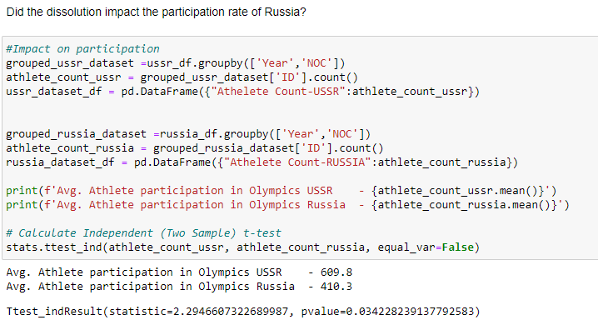
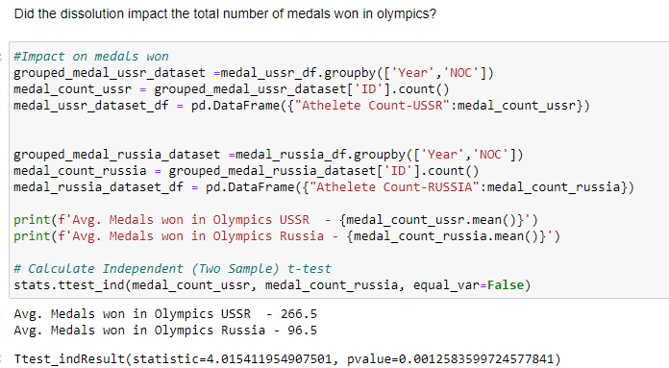
Project Scope Analysis – T-Test Soviet Union vs. Russia
Did the dissolution impact the athlete’s participation rate for Russia?
Athlete Participation Analysis : The average athlete participation for Russia after dissolution is lower than that of URS, but this is understandable given that the data excludes other countries’ participation. The p-value of 0.034 in the t-test indicates that there is evidence against the null hypothesis, thus we can reject the null hypothesis and accept the alternate hypothesis for our further analysis.
Did the dissolution impact the total number of medals by Russia?
Medals won Analysis : The p-value for medal analysis is 0.0012 .It indicates strong evidence against the null hypothesis, as there is less than a 5% probability the null is correct (and the results are random). Therefore, we reject the null hypothesis, and accept the alternative hypothesis for our further analysis
#USSR Dataset [1956 - 1992]
ussr_df = complete_subset_df.loc[((complete_subset_df['NOC'] == 'URS' )|(complete_subset_df['NOC'] == 'EUN'))]
# Russia DataSet [1994 - 2012]
russia_df = complete_subset_df.loc[(complete_subset_df['NOC'] == 'RUS')]

Slide 16
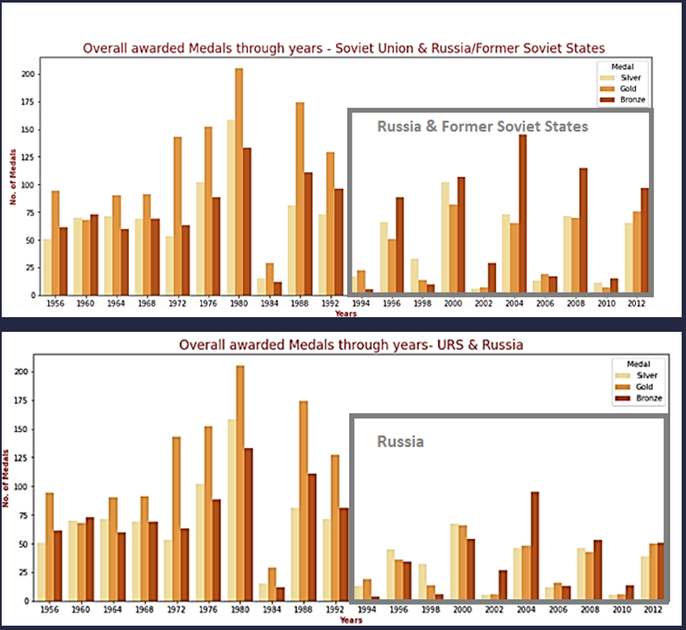
Medals Won – 1956 - 2012

Slide 17
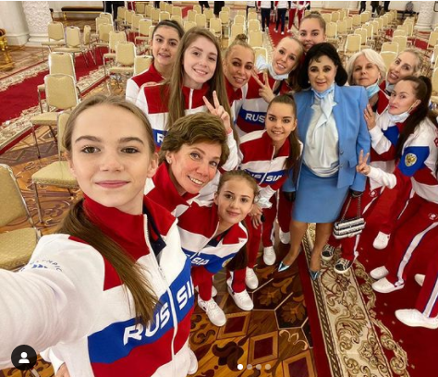
Helena Zhang

Slide 18
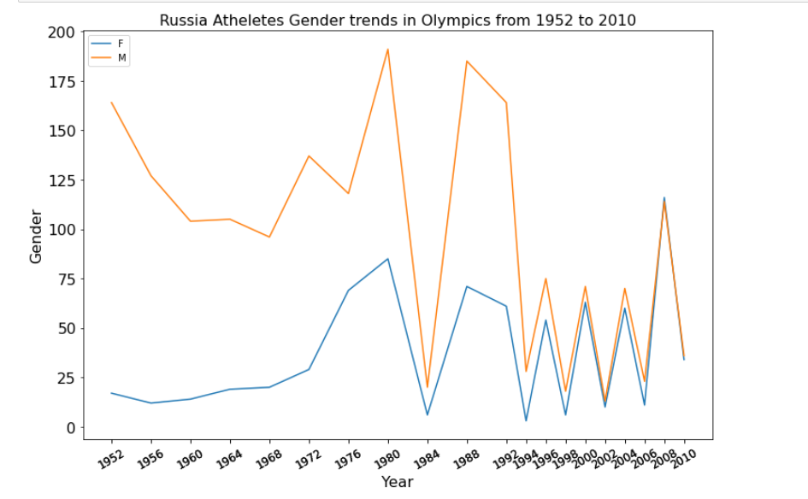
Athletes Gender Analysis
1950s-1960s Male athletes had an overwhelming percentage of the participates population, while few female athletes completed on behalf of Soviet Union.
The ratio of female participation has been improving. In recent years female athletes' percentage has been increasing even surpassing the male athletes' ratio.

Slide 19
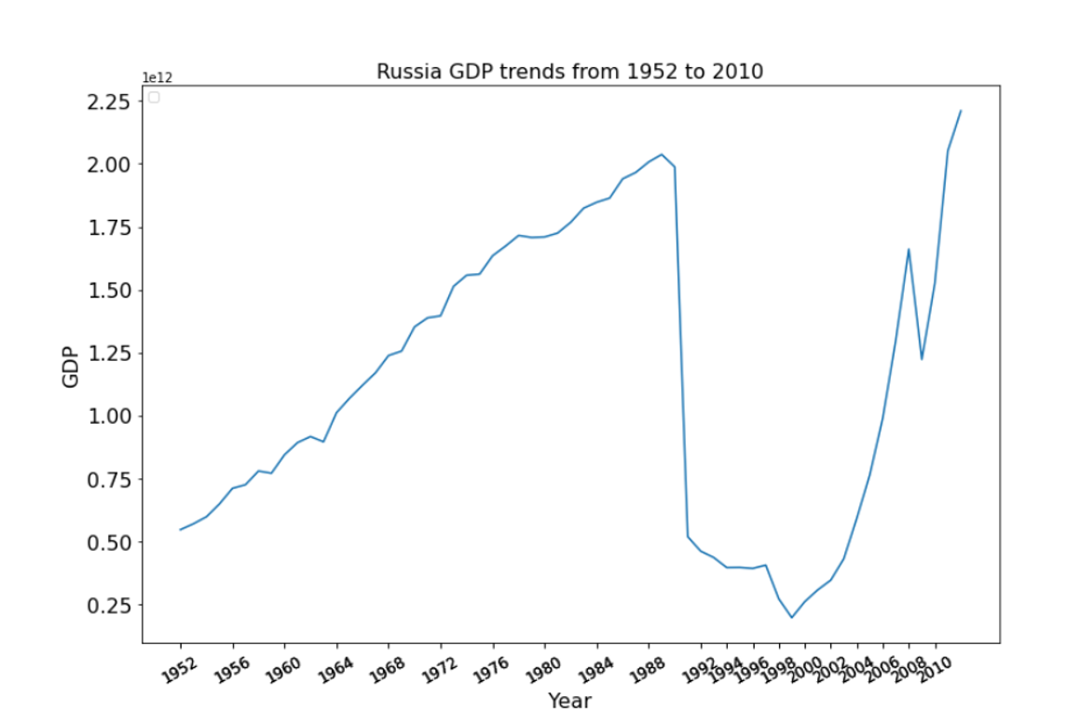
Soviet Union/Russia National Nominal GDP Analysis
GDP witnessed decades of increase before dissolution.
Following the collapse of the Soviet Union, the GDP took a dramatic drop.
GDP number had been collapsing through 1990’s but Russia bounced back from the August 1998 financial crash with a surprising speed.

Slide 20
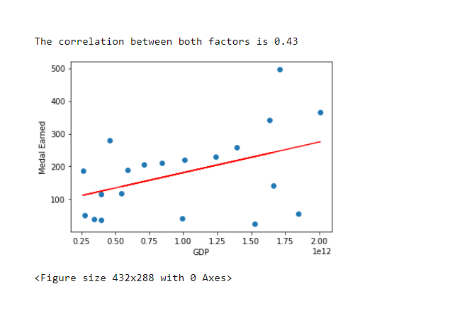
Nominal GDP/ Medal earned correlation Analysis
The plot examines the total medal counts vary with Soviet Union/ Russia country nominal GDP.
The correlation is 0.43
Relationship is not too far from linear. The graph suggests the GDP and medal counts over the years are positively correlated.

Slide 21
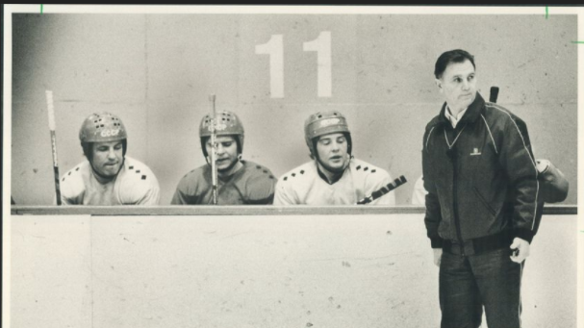
Greg Behnke

Slide 22
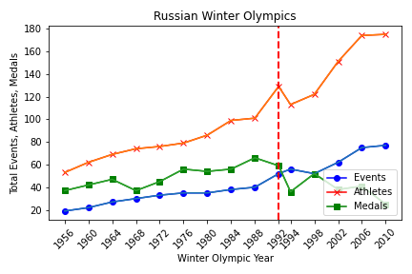
Russian Winter Olympics (Events, Athletes, Medals)
This chart shows that after the period of dissolution of the USSR(1988-1991) the number of athletes representing Russia and the number of medals earned dropped precipitously, although the number of events saw a small increase It is interesting to note that from the winter Olympics of 1988 to 1992 the number of athletes and events both rose, while the number of medals earned dropped.

Slide 23
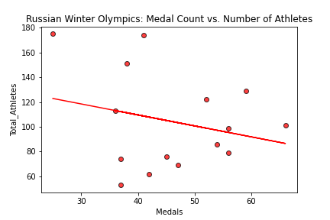
Russian Winter Olympics: Medal Count vs. Number of Athletes
With an R2 value of only .06 and a correlation coefficient of -.25 it seems there is weak a connection between the number of athletes and the number of medals earned for Russia during the winter Olympics. The number of athletes explains about one quarter of the variability in the number of medals earned, however one or more other factors are certainly impacting performance.

Slide 24
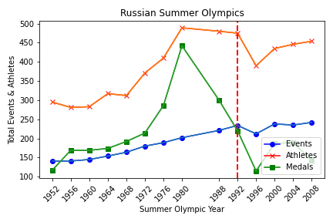
Russian Summer Olympics (Events, Athletes, Medals)
This chart shows that the dissolution of the former Soviet Union took a more drastic toll on the Russian summer Olympic delegation.
While the number of medals earned was already dropping, both the number of athletes and the number of events also trended downward after the point of interest.

Slide 25
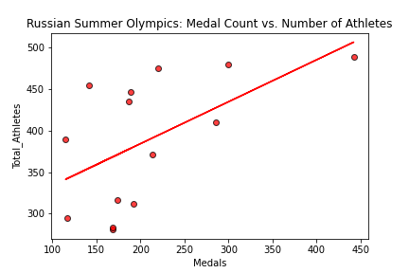
Russian Summer Olympics: Medal Count vs. Number of Athletes
With a correlation coefficient of 0.56 and an R2 value of 0.31 the number of medals earned seems to have a slightly stronger relationship with the number of Russian athletes competing in the summer Olympics, with the number of athletes accounting for over 31% of the variability in the number of medals earned.

Slide 26
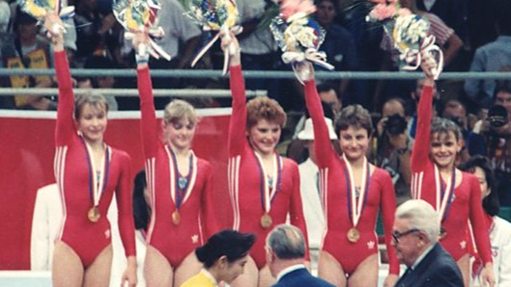
Elizabeth Labno

Slide 27
Population vs Medal Counts in Soviet (USSR), Russian Federation, and Ex-Soviet States Deep Dive
1. UN Dataset allowed for detailed analysis of population by countries and blocs of countries.
2. Cleaned the data and broke them into a total of 6 data sets.
3. Performed quality check by comparing results to teammates completed tables AND publicly available data.

Slide 28
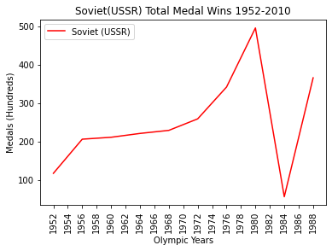
Question:
What was the total medal count for the Soviets leading up to 1991?
Answer:
Soviet medal counts began to rise sharply in about 1970 only to crash in 1984 with the Olympic Boycott of athletes. They rose again until 1988.

Slide 29
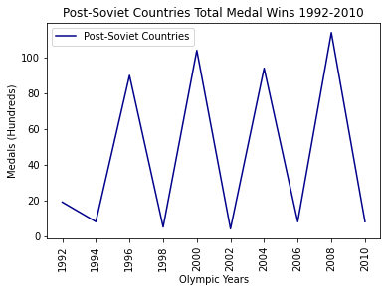
Question: What was the total medal count/pattern for Post-Soviet Countries after 1991?
Answer:
Post-Soviet Countries had volatile showings post 1991 with dips in performance in 1994, 1998, 2002, 2006, 2010

Slide 30
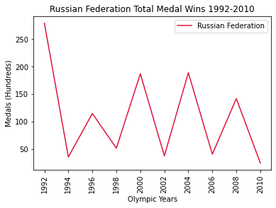
Question: What was the total medal count/pattern for Russian Federation after 1991?
Answer:
Russian Federation had volatile showings post 1991 with dips in performance in 1994, 1998, 2002, 2006, 2010.

Slide 31
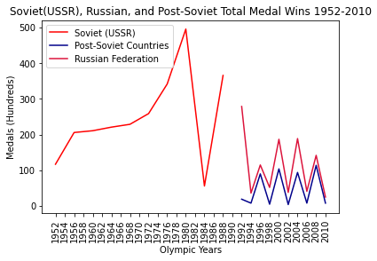
Question: How do medal counts for the three populations compare?
Answer:
USSR medal counts peaked in 1980. Post 1991 the Russian Federation and Post-Soviet states maintain similar win patterns with the Russian Federation in the lead with consistently higher rates of medal wins.

Slide 32
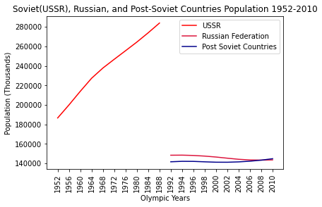
Question: What was the total population of the USSR from 1952-1988 compared to the population of the Russian Federation and the Post Soviet Countries
Answer:
Population of USSR roughly halved in 1991 with a nearly even split between the Russian Federation and Post Soviet Countries.

Slide 33
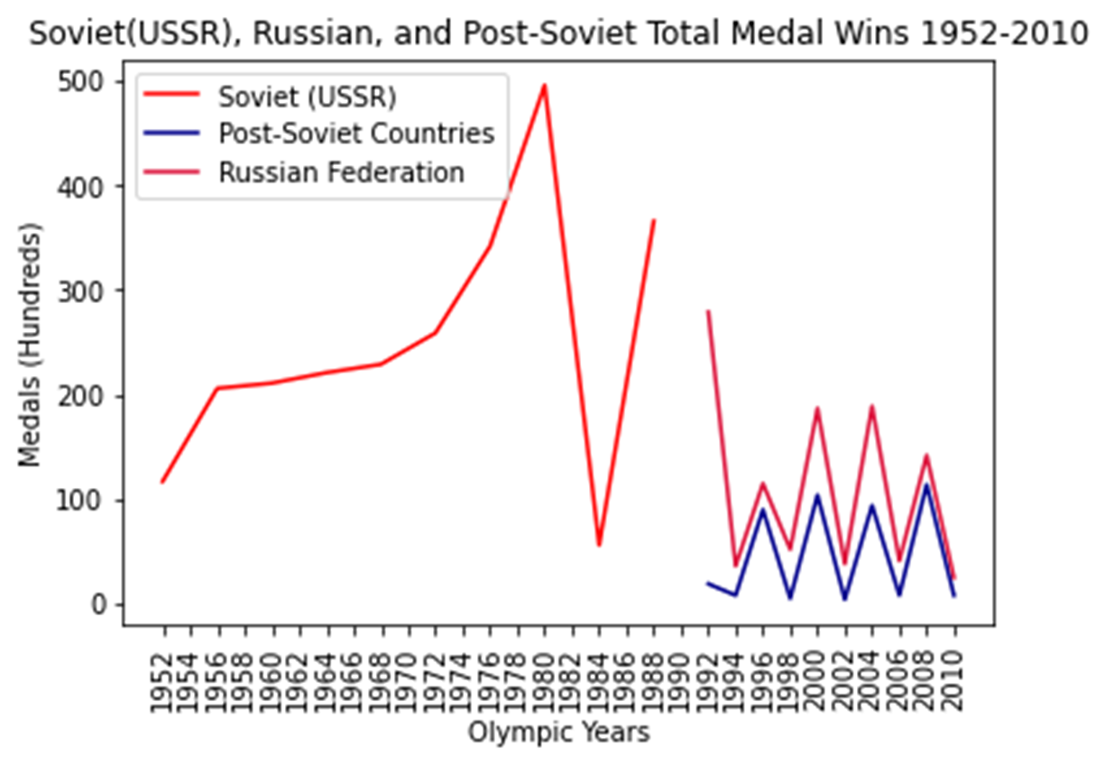
Side by Side Comparison Medal Wins and Population
Based on a side-by-side comparison population and medal wins split between the Russian Federation and Post Soviet Countries. Wins and Population have a similar pattern.

Slide 34
Potential areas of further investigation
Further analysis of the geo distribution of athletes across the USSR and how the new borders affected individual Olympic team performance over time.
Deep dive into how funding and appeal to national pride may affect whole country performance.
Soviet influence on international participation of women in sports.
1992 was an outlier year. We included it in analysis of Russian Federation but was comprised of Russia and 12 of 15 Post-Soviet States.
Prove correlation and causation between population and medal count by country.

Slide 35
Sources
https://www.history.com/news/romanov-family-murder-execution-reasons
https://www.history.com/topics/russia/history-of-the-soviet-union
https://library.ryerson.ca/asc/files/2015/01/Above-Crowd.jpg
as.rochester.edu/mlc/news-events/calendar/2017/02/back-to-the-future-the-fall-of-the-soviet-union-and-its-consequences-after-25-years.html- Slide 4
https://news.artnet.com/art-world/russian-art-at-the-royal-academy-review-851075
https://history.howstuffworks.com/historical-figures/joseph-stalin.htm
https://www.hawaii.edu/powerkills/NOTE1.HTM
https://www.1stdibs.com/furniture/wall-decorations/posters/original-vintage-soviet-winter-sport-poster-ice-skating-fitness-health/id-f_12234341/
https://www.bygonely.com/soviet-sports-propaganda-posters/
https://www.reddit.com/r/PropagandaPosters/comments/gwxqgf/soviet_propaganda_poster_sport_in_the_ussr_sport/
https://core.ac.uk/download/pdf/210599851.pdf
https://www.jstor.org/stable/40202563
Overall presentation was informed by:
olympic-medals-20210726 (npr.org)
21 Soviet Sport Propaganda Posters From the Mid-20th Century ~ Vintage Everyday

Slide 36
Sources cont…
https://core.ac.uk/download/pdf/210599851.pdf
https://www.jstor.org/stable/40202563
olympic-medals-20210726 (npr.org)
21 Soviet Sport Propaganda Posters From the Mid-20th Century ~ Vintage Everyday
Economy study published dataset: GDP of Soviet Union pre 1991: Maddison, Angus (2006). The World Economy (PDF). Paris, France: Development Centre of the Organization for Economic Co-operation and Development (OECD). pp. 400–600. ISBN 978-92-64-02261-4.
Kaggle dataset: GDP data after 1991 for various countries including Russia https://www.kaggle.com/tunguz/country-regional-and-world-gdp?select=gdp_csv.csvb
United Nation website: Population date for various countries including Soviet Union pre 1991 and Russia post 1991 https://population.un.org/wpp/Download/Standard/Population/
https://www.npr.org/sections/thetorch/2018/02/06/583570854/32-russian-athletes-appeal-doping-bans-in-hopes-of-competing-in-pyeongchang
Arina and Dina Averins️️️️️ on Instagram: “🧙🏼🔮🧙🏼”
https://www.thestar.com/sports/hockey/2014/11/24/legendary_soviet_hockey_coach_viktor_tikhonov_

